Slide 1
An Introduction to R Following the book: ISLR C.A.L. with Lads and Lasses Who R September 2018
Stu Rodgers
Notes:
1

Slide 2
A Brief Outline of this CAL
Introductions
Brief overview of R Resources
ISLR Book Overview
Datasets and nomenclature
Code walk through in R
Some of the figures in this presentation are taken from "An Introduction to Statistical Learning, with applications in R" (Springer, 2013) with permission from the authors: G. James, D. Witten, T. Hastie and R. Tibshirani

Slide 3
Introductions
Name
Your interest in this topic/event
Your experience with R
Your experience with statistical learning

Slide 4
A Brief Tour of Online Resources for R September 2018
Stu Rodgers
Notes:
4

Slide 5
Great places to start
http://www.r-project.org/
http://cran.r-project.org/manuals.html
An Introduction to R
The R language definition
Writing R Extensions
R Data Import/Export
R Installation and Administration
R Internals
The R Reference Index
http://journal.r-project.org/
google search
<search terms> site:journal.r-project.org
<search terms> site:www.r-project.org/doc/Rnews

Slide 6
Great places to learn more
Mailing Lists http://www.r-project.org/mail.html
R-help - r-help@R-project.org
CRAN Task Views http://cran.r-project.org/web/views/
Contributed Documentation http://cran.r-project.org/other-docs.html
Docs with > 100 pages
Docs with < 100 pages
Reference cards
Other languages

Slide 7
Some suggested extras
Journal of Statistical Software
http://www.jstatsoft.org/
Online text called QUICK-R: http://www.statmethods.net/
Some hints for the R beginner http://www.burns-stat.com/pages/Tutor/hints_R_begin.html
UCLA academic on-line courses https://stats.idre.ucla.edu/r/

Slide 8
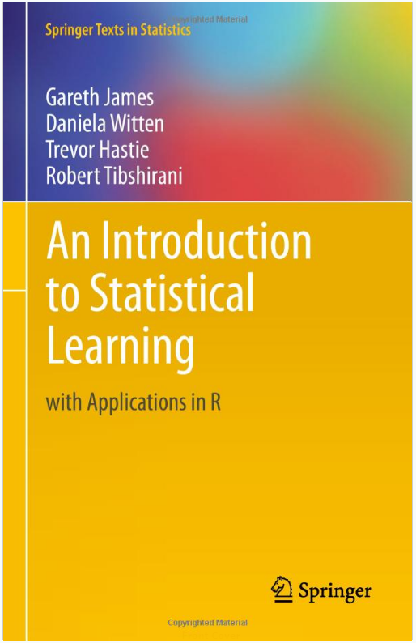
http://www-bcf.usc.edu/~gareth/ISL/
The book, ISLR, published in 2013.
Each chapter contains an R lab with examples.
This seminar will mostly follow this book.

Slide 9
Datasets
Wage Data; Stock Market Data; Gene Expression Data
Data sets in package ‘ISLR’:
Auto Auto Data Set
Caravan The Insurance Company (TIC) Benchmark
Carseats Sales of Child Car Seats
College U.S. News and World Report's College Data
Credit Credit Card Balance Data
Default Credit Card Default Data
Hitters Baseball Data
Khan Khan Gene Data
NCI60 NCI 60 Data (gene expression data)
OJ Orange Juice Data
Portfolio Portfolio Data
Smarket S&P Stock Market Data
Wage Mid-Atlantic Wage Data
Weekly Weekly S&P Stock Market Data
Installing and Loading packages in R
install.packages(c(“ISLR"), repos='http://cran.us.r-project.org')
library(“ISLR")
data()
summary(Wage)

Slide 10
Nomenclature
Observations – n Variables – p
Wage data set consists of 12 variables for 3,000 people
n = 3,000 observations
p = 12 variables (such as year, age, , and more)
Matrices and Vectors
X denotes a n×p matrix - (i, j)th element is – x_{ij}
Vectors normally shown as columns
Wage data set in R

Slide 11
Nomenclature
Models
inputs - predictors, independent variables, features
outputs - responses, dependent variables
quantitative outputs - Y
qualitative outputs - G (for group)
quantitative variables - numbers
qualitative variables - factors, categorical, discrete
“success” “failure”; “survived” “died”; “red” “blue”
regression = predict quantitative outputs
classification = predict qualitative outputs

Slide 12
Code walk through in R
Lab from Chapter 2
Lab from Chapter 3

Slide 13
Questions
Stu Rodgers
stu10887@gmail.com

